Slide 1
Plasmon Hybridization in Metal Nanoparticle Clusters and Oligomers
Nicholas P. Montoni
Final Doctoral Exam
Committee Chair: Prof. David Masiello
June 5th, 2018

Slide 2
Nanophotonics

Slide 3
Nanophotonics
Nanotechnology
Photonics

Slide 4
Nanophotonics
Nanotechnology
Photonics
Feynman: “there’s room at the bottom” 1954

Slide 5
Nanophotonics
Nanotechnology
Photonics
Feynman: “there’s room at the bottom” 1954
Taniguchi: “on the basic concept of nanotechnology” 1974

Slide 6
Nanophotonics
Nanotechnology
Photonics
Feynman: “there’s room at the bottom” 1954
Taniguchi: “on the basic concept of nanotechnology” 1974
Drexler: “molecular manufacturing” 1981

Slide 7
Nanophotonics
Nanotechnology
Photonics
(photon electronics)
Feynman: “there’s room at the bottom” 1954
Bell: the photophone
Taniguchi: “on the basic concept of nanotechnology” 1974
Drexler: “molecular manufacturing” 1981

Slide 8
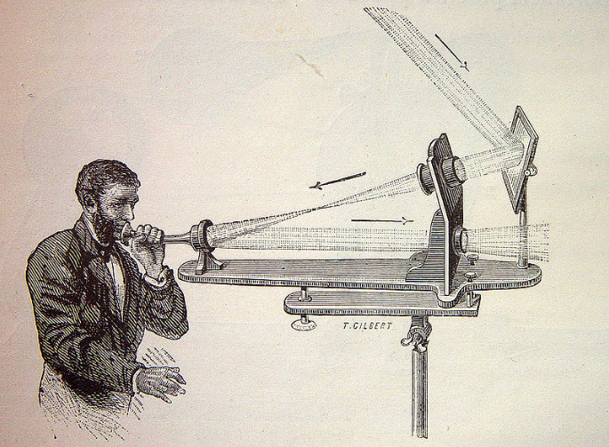
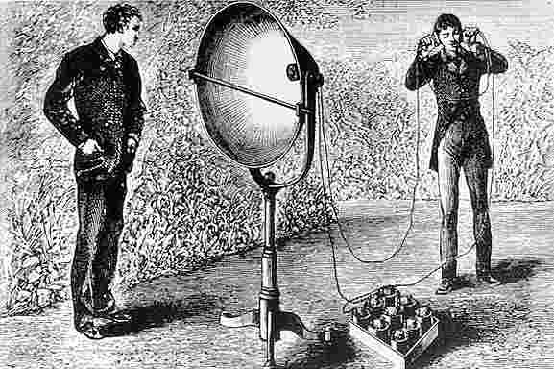
THE PHOTOPHONE

Slide 9
Nanophotonics
Nanotechnology
Photonics
(photon electronics)
Feynman: “there’s room at the bottom” 1954
Bell: the photophone, 1880
Taniguchi: “on the basic concept of nanotechnology” 1974
Mainer: Light Amplification by Stimulated Emission of Radiation (LASER), 1960
Drexler: “molecular manufacturing” 1981

Slide 10
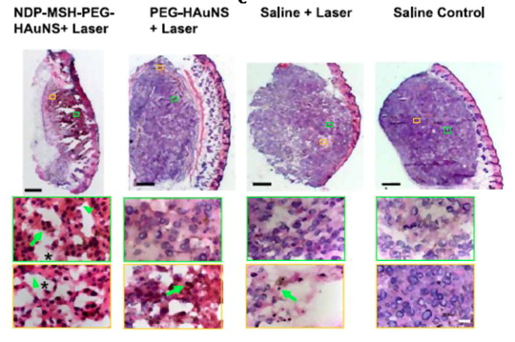
What can nanophotonics do?
Cancer therapy
Huang, X. and El-Sayed, M. A. Alexandria Journal of Medicine. 2011.

Slide 11
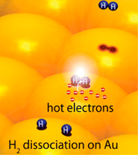
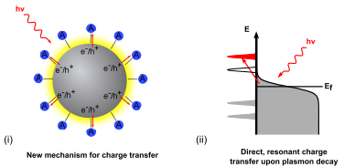
What can nanophotonics do?
Chemical catalysis
N. Halas et al. Nano Lett. 2012.
S. Linic et al. ACS Nano. 2015.

Slide 12
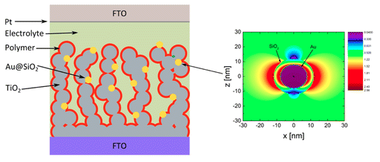
What can nanophotonics do?
Photovoltaic devices
Sanden, S. et al. J. Phys. Chem. C. 2015.

Slide 13
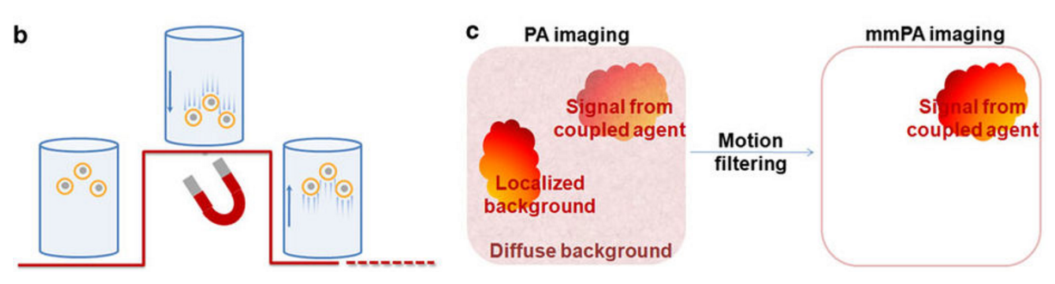
What can nanophotonics do?
Biological sensing and imaging
Jin, Y. et al. Nat. Comm. 2010

Slide 14
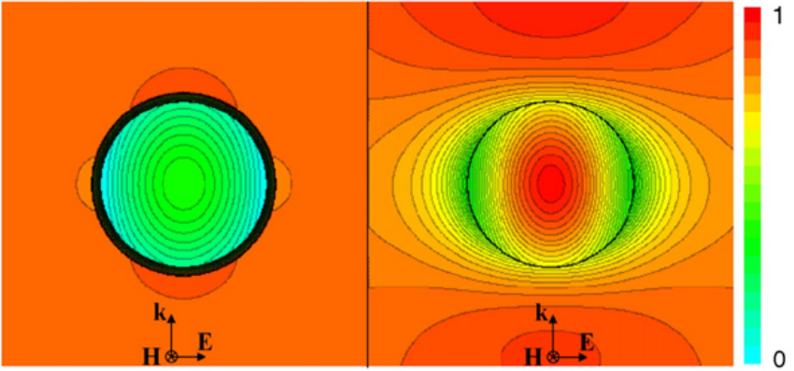
What can nanophotonics do?
Electromagnetic cloaking
Guild, M. et al. Wave Motion 2011

Slide 15
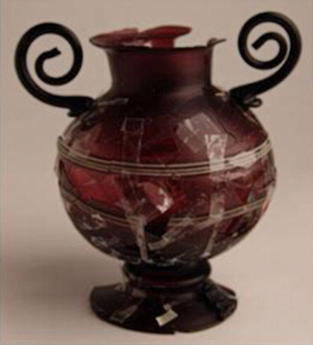
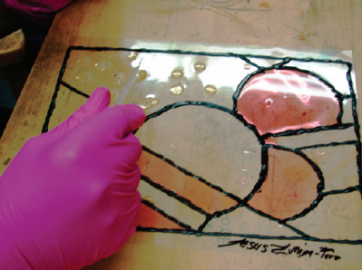
What can nanophotonics do?
The arts!
Ruivo, A. et al. Journal of Cultural Heritage. 2008.
Duncan, K. A., et al. J. Chem. Ed. 2010.

Slide 16
Past and present work
S. C. Quillin, C. Cherqui, N. P. Montoni, G. Li, J. P. Camden, and D. J. Masiello. “Imaging Plasmon Hybridization in Metal Nanoparticle Aggregates Using Electron Energy-Loss Spectroscopy.” J. Phys. Chem. C, 2016.
S. Griffin, N. P. Montoni, G. Li, P. J. Straney, J. E. Millstone, D. J. Masiello, and J. P. Camden. “Imaging Energy Transfer in Pt-Decorated Au Nanoprisms via Electron Energy-Loss Spectroscopy.” J. Phys. Chem. Lett., 2016.
C. Cherqui, Y. Wu, G. Li, S. C. Quillin, J. A. Busche, N. Thakkar, C. West, N. P. Montoni, P. D. Rack, J. P. Camden, and D. J. Masiello. “STEM/EELS Imaging of Magnetic Hybridization in Symmetric and Symmetry-Broken Plasmon Oligomer Dimers and All-Magnetic Fano Interference.” Nano Lett. 2016.
N. Thakkar, N. P. Montoni, C. Cherqui, and D. J. Masiello. “Quantum Plasmon Resonances in Active Environments.” Phys. Rev. B 2018.
N. P. Montoni, S. C. Quillin, C. Cherqui, and D. J. Masiello. “Magnetic Effects in Metal Nanoparticle Arrays.” ACS Photonics, ASAP.
N. P. Montoni, C. A. West, J. A. Busche, P. D. Rack, G. Duscher, and D. J. Masiello. “Stimulated Electron Energy-Loss Spectroscopy.” In preparation, 2018.

Slide 17
Goals for today:
Learn about plasmons in metal nanoparticles
Learn how plasmons behave in clusters of metal nanoparticles
Qualitatively describe plasmon hybridization in mixed-metal, mixed-geometry clusters
Introduce size and magnetic effects to our model of cluster behavior
Accurately describe the plasmon resonances of large, finite clusters

Slide 18
Metal

Slide 19
Light
Metal

Slide 20
Light
Metal

Slide 21
Light
Metal

Slide 22
Metal
10s of nm
Light
Skin depth

Slide 23
Light
100s of nm
(one half-wavelength)
10s of nm
(Approximately the same size as the skin depth!)

Slide 24
Light
E_{ext}

Slide 25
Light
E_{ext}

Slide 31
Electric dipole plasmon

Slide 32
Light scattering
Electric dipole plasmon decay mechanisms

Slide 33
Light scattering
Electric dipole plasmon decay mechanisms
Local heating

Slide 34
“hot electron” generation
Light scattering
Electric dipole plasmon decay mechanisms
Local heating

Slide 35
An analogy:

Slide 36
An analogy:

Slide 37
An analogy:

Slide 38
An analogy:

Slide 39
An analogy:

Slide 40
An analogy:

Slide 41
An analogy:

Slide 42
An analogy:

Slide 43
Plasmon → spring

Slide 44
Frequency-Dependent Polarizability

Slide 45
Time-Dependent Polarizability and Oscillator Response

Slide 46
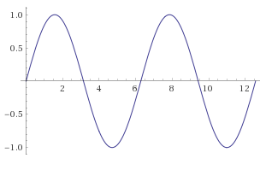
Time-Dependent Polarizability and Oscillator Response

Slide 47
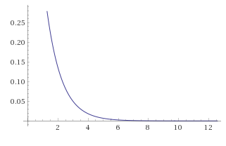
Time-Dependent Polarizability and Oscillator Response

Slide 48
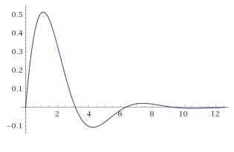
Time-Dependent Polarizability and Oscillator Response

Slide 49
Time-Dependent Response of Various Metals

Slide 50
Time-Dependent Response of Various Metals

Slide 51
Time-Dependent Response of Various Metals

Slide 52
Time-Dependent Response of Various Metals

Slide 53
Time-Dependent Response of Various Metals

Slide 54
Time-Dependent Polarizability and Oscillator Response

Slide 55
Goals for today:
Learn about plasmons in metal nanoparticles
Learn how plasmons behave in and clusters of metal nanoparticles
Qualify and quantify plasmon hybridization in mixed-metal, mixed-geometry clusters
Introduce size and magnetic effects to our model of cluster behavior
Accurately describe the plasmon resonances of large, finite clusters

Slide 56
Goals for today:
Learn about plasmons in metal nanoparticles
Learn how plasmons behave in clusters of metal nanoparticles
Qualify and quantify plasmon hybridization in mixed-metal, mixed-geometry clusters
Introduce size and magnetic effects to our model of cluster behavior
Accurately describe the plasmon resonances of large, finite clusters

Slide 58
Higher-energy, parallel, anti-bonding mode
Energy
Lower-energy, anti-parallel, bonding mode

Slide 59
Dipole-dipole interaction energy

Slide 60
Dipole-dipole interaction energy

Slide 61
Dipole-dipole interaction energy
Near-field Term

Slide 62
Dipole-dipole interaction energy
Near-field Term
Intermediate-field Term

Slide 63
Dipole-dipole interaction energy
Near-field Term
Intermediate-field Term
Far-field Term

Slide 64
Dipole-dipole interaction energy
Near-field Term
Intermediate-field Term
Far-field Term

Slide 65
Taking the quasistatic limit…
Quasistatic coupling is near-field coupling

Slide 66
Quasistatic Interactions of a MNP Dimer
anti-collinear
parallel
anti-parallel
collinear

Slide 67
Quasistatic Interactions of a MNP Dimer
anti-collinear
parallel
anti-parallel
collinear

Slide 68
Coupled oscillator equations of motion

Slide 69
Solving coupled oscillator equations of motion

Slide 70
For an arbitrary number of nanoparticles:

Slide 71
Goals for today:
Learn about plasmons in metal nanoparticles
Learn how plasmons behave in clusters of metal nanoparticles
Qualitatively describe plasmon hybridization in mixed-metal, mixed-geometry clusters
Introduce size and magnetic effects to our model of cluster behavior
Accurately describe the plasmon resonances of large, finite clusters

Slide 72
Goals for today:
Learn about plasmons in metal nanoparticles
Learn how plasmons behave in clusters of metal nanoparticles
Qualitatively describe plasmon hybridization in mixed-metal, mixed-geometry clusters
Introduce size and magnetic effects to our model of cluster behavior
Accurately describe the plasmon resonances of large, finite clusters

Slide 73
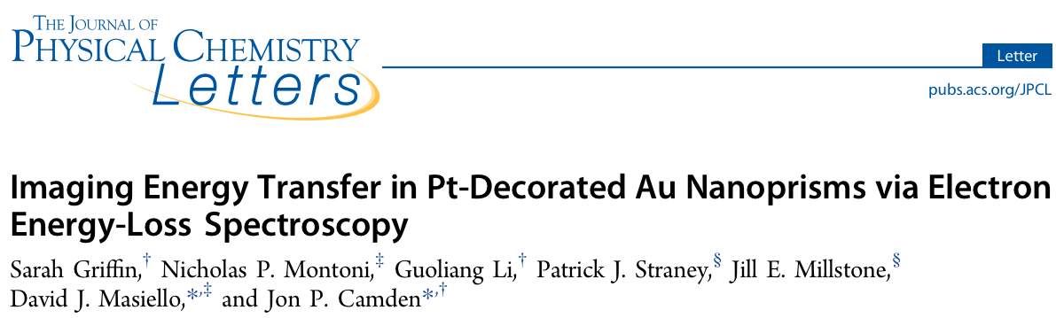
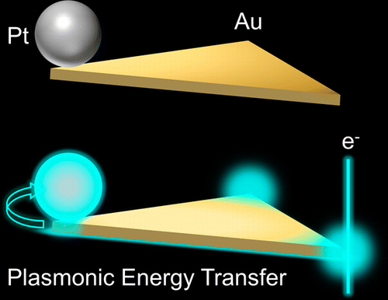

Slide 74
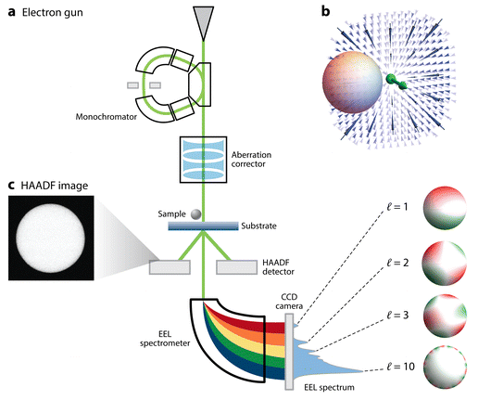
A Quick Intro to Electron Energy-Loss Spectroscopy (EELS)
Cherqui, C., Thakkar, N., Li, G., Camden, J. P., and Masiello, D. J. Annu. Rev. Phys. Chem. 2016.

Slide 75
Generate a spectrum…

Slide 76
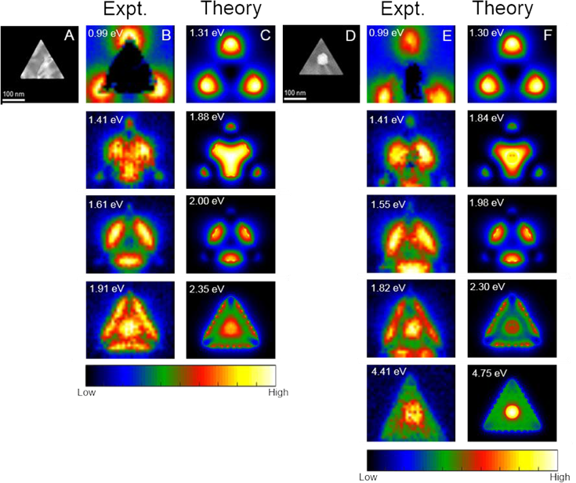
… or generate maps!

Slide 77
Experimental (and simulated) results

Slide 78
Experimental (and simulated) results

Slide 79
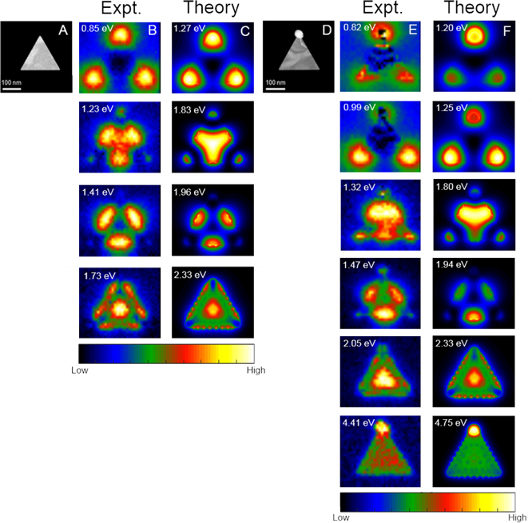
Experimental (and simulated) results
Split corner dipole modes!

Slide 80
Experimental (and simulated) results

Slide 81
A qualitative model of the nanoprism

Slide 82
A qualitative model of the nanoprism
Energy

Slide 83
A qualitative model of the nanoprism
Energy
This one will be relevant later…

Slide 84
A qualitative model of the nanoprism
Energy

Slide 85
A qualitative model of the nanoprism
Energy

Slide 86
A qualitative model of the nanoprism
Energy

Slide 87
Adding a (small) perturbation
Energy

Slide 88
Adding a (small) perturbation
Energy

Slide 89
Adding a (small) perturbation
Energy

Slide 90
Location- and orientation- dependence of plasmon hybridization!

Slide 91
What have we learned?
Even a small perturbation has experimentally observable impacts on the plasmonic spectrum of a nanocluster
The strength of the perturbation is location-dependent
Symmetry-breaking leads to spatial localization of energy

Slide 92
Goals for today:
Learn about plasmons in metal nanoparticles
Learn how plasmons behave in small particles and clusters of particles
Qualitatively describe plasmon hybridization in mixed-metal, mixed-geometry clusters
Introduce size and magnetic effects to our model of cluster behavior
Accurately describe the plasmon resonances of large, finite clusters

Slide 93
Goals for today:
Learn what a plasmon is and why we should care
Learn how plasmons behave in small particles and clusters of particles
Qualitatively describe plasmon hybridization in mixed-metal, mixed-geometry clusters
Introduce size and magnetic effects to our model of cluster behavior
Accurately describe the plasmon resonances of large, finite clusters

Slide 94
Quasistatic coupling

Slide 95
Fully retarded coupling
Near-field Term
Intermediate-field Term
Far-field Term

Slide 96
Fully Retarded Interaction Energies in a MNP Dimer

Slide 97
Fully Retarded Interaction Energies in a MNP Dimer
Quasistatic
Fully Retarded

Slide 98
Quasistatic Solution

Slide 99
Solutions with Retardation Effects

Slide 100
Solutions with Retardation Effects
The same omega!

Slide 101
Goals for today:
Learn what a plasmon is and why we should care
Learn how plasmons behave in small particles and clusters of particles
Qualitatively describe plasmon hybridization in mixed-metal, mixed-geometry clusters
Introduce size and magnetic effects to our model of cluster behavior
Accurately describe the plasmon resonances of large, finite clusters

Slide 102
Goals for today:
Learn what a plasmon is and why we should care
Learn how plasmons behave in small particles and clusters of particles
Qualitatively describe plasmon hybridization in mixed-metal, mixed-geometry clusters
Introduce size and magnetic effects to our model of cluster behavior
Accurately describe the plasmon resonances of large, finite clusters

Slide 103
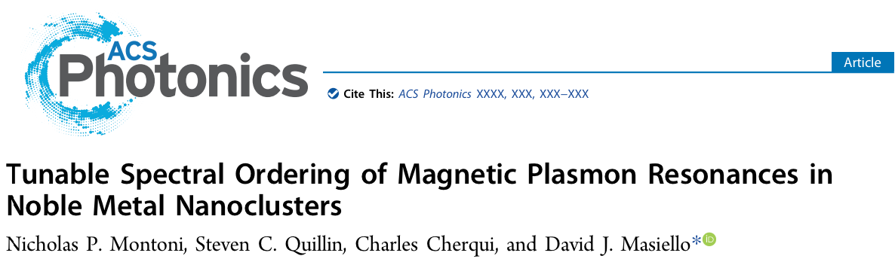
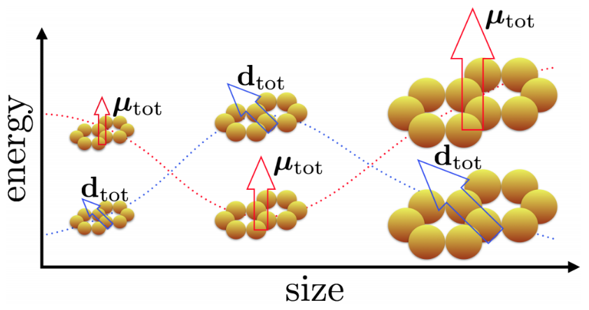

Slide 104
What does “magnetic” mean?

Slide 105
What does “magnetic” mean?

Slide 106
Cyclic dipoles: like cyclic currents

Slide 107
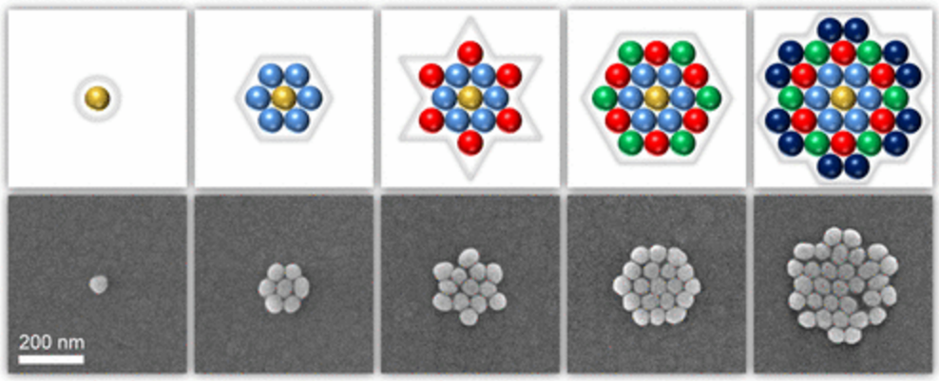
Motivation: Size Dependence
Intermediate size regime:
Greybush, J. et al. ACS Nano 2017

Slide 108
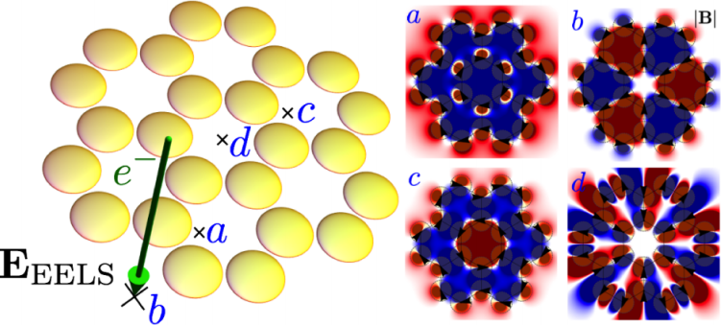
Motivation: Accurate Model
Cherqui, C. et al. ACS Photonics 2014

Slide 109
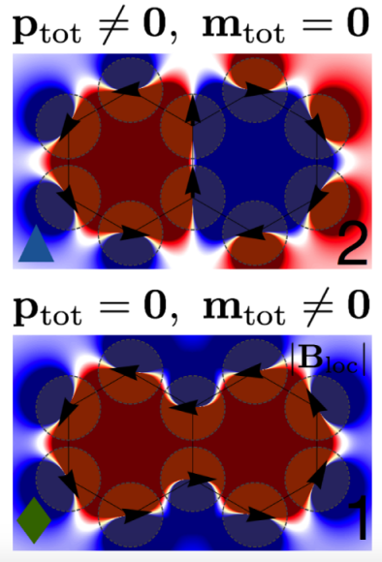
Motivation: Accurate Model
Quasistatic Tight-Binding Model
Energy
Cherqui, C. et al. ACS Photonics 2014

Slide 110
Motivation: Accurate Model
Quasistatic Tight-Binding Model
Full-wave Simulations
Energy
Switch order!
Cherqui, C. et al. ACS Photonics 2014

Slide 111
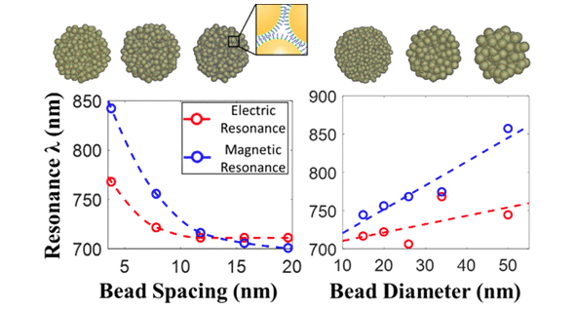
Motivation: Accurate Model
Li, C., Lee, S., Qian, Z., Woods, C., Park, S.-J., and Fakhraai, Z. J. Phys. Chem. C. 2018

Slide 112
Model System: Arrays of Silver Nanospheres

Slide 113
Magnetic Plasmons of the 2-mer and 3-mer

Slide 114
Investigate spectral switching via system size

Slide 115
The size-dependence of magnetic plasmon energetics

Slide 116
The size-dependence of magnetic plasmon energetics

Slide 117
Distinguishing the magnetic plasmons

Slide 118
Directional Radiation from Electric and Magnetic Dipole Moments
y
x
z

Slide 119
Directional Radiation from Electric and Magnetic Dipole Moments

Slide 120
Directional Radiation from Electric and Magnetic Dipole Moments

Slide 121
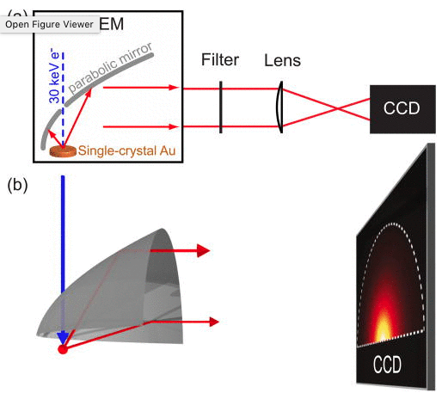
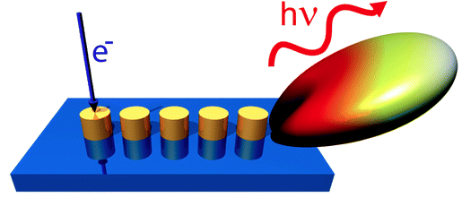
Measuring the angular dependence of scattered light
Coenen, T., Vesseur, E. J. R., Polman, A., and Koenderink, F. Nano Lett. 2011
Coenen, T., Vesseur, E. J. R., and Polman, A. Appl. Phys. Lett. 2011

Slide 122
Angle Resolved CL spectra of magnetic oligomers

Slide 123
Experimentally Relevant Nanoclusters
Greybush, J. et al. ACS Nano 2017

Slide 124
Experimentally Relevant Nanoclusters

Slide 125
Magnetic Plasmon Spectrum of Hexagonally Packed Nanoclusters

Slide 126
Magnetic Plasmon Spectrum of Hexagonally Packed Nanoclusters

Slide 127
Angle Resolved CL of Hexagonally Packed Nanoclusters

Slide 128
Angle Resolved CL of Hexagonally Packed Nanoclusters

Slide 129
Angle Resolved CL of Hexagonally Packed Nanoclusters

Slide 130
Angle Resolved CL of Hexagonally Packed Nanoclusters

Slide 131
What have we learned?
The spectral ordering of magnetic plasmons depends on cluster shape and size
Simulated angle-resolved CL can identify these mode-crossings

Slide 132
Goals for today:
Learn what a plasmon is and why we should care
Learn how plasmons behave in small particles and clusters of particles
Qualitatively describe plasmon hybridization in mixed-metal, mixed-geometry clusters
Introduce size and magnetic effects to our model of cluster behavior
Accurately describe the plasmon resonances of large, finite clusters

Slide 133
Future work: Stimulated Electron Energy-Loss Spectroscopy

Slide 134
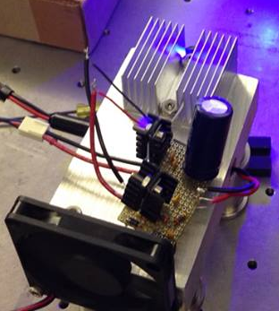
Future work: Stimulated Electron Energy-Loss Spectroscopy

Slide 135
Stimulated EELS
abs

Slide 136
Stimulated EELS

Slide 137
Extracurriculars Community-Building and Science Advocacy
“Imagine if this type of work was a recognized part of your Ph.D.”
– Dr. Sarah Vorpahl
Founder and President, Out in STEM at UW
Founder, Chemistry Department Mentorship Network
Organizer, Strengthening STEM through Diversity
Organizer, Strategies for Cultivating Inclusion in STEM
Clean Energy Institute Education and Training Fellow
Pacific Science Center Science Communication Fellow
Speaker, 2018 March for Science - Seattle
Husky 100, 2017 Cohort
Secretary, Women in Chemical Sciences (2015-2016)

Slide 138
Acknowledgements
My Doctoral Committee
Prof. David Masiello
Prof. David Ginger
Prof. Sarah Keller
Prof. Elizabeth Nance

Slide 139
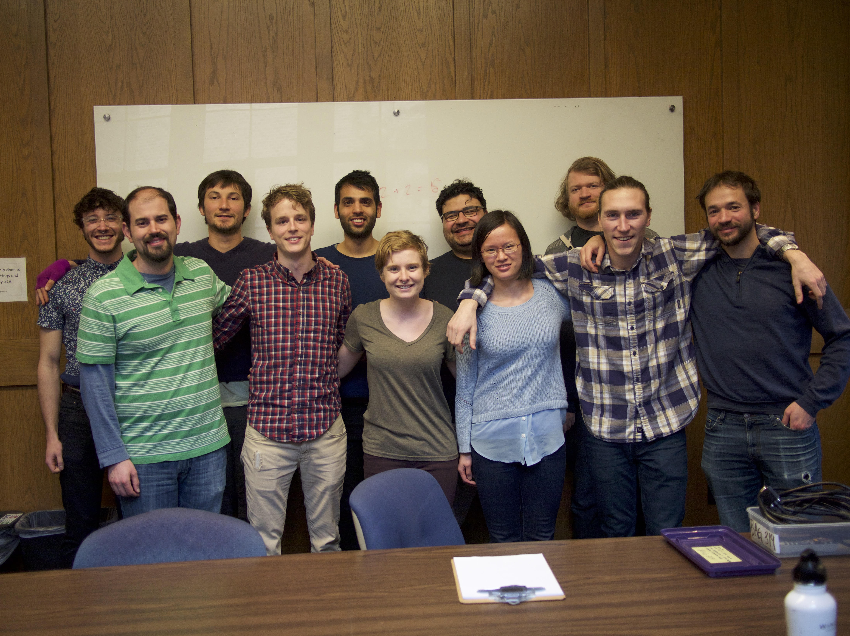
Acknowledgements
The Masiello Group:
Prof. David Masiello
Dr. Charles Cherqui
Dr. Zhaoxia Qian
Dr. Nicholas Bigelow
Dr. Niket Thakkar
Dr. Steven Quillin
Jacob Busche
Harrison Goldwyn
Kevin Smith
Elliot Beutler
Claire West
The Masiello group, March 2017

Slide 140
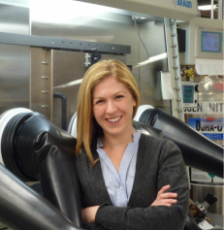

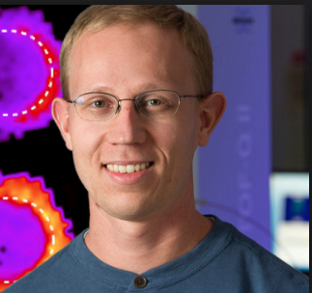

Acknowledgements
Experimental collaborators
Dr. Sarah Griffin
Prof. Jon Camden
Dr. Patrick Straney
Prof. Jill Millstone

Slide 141
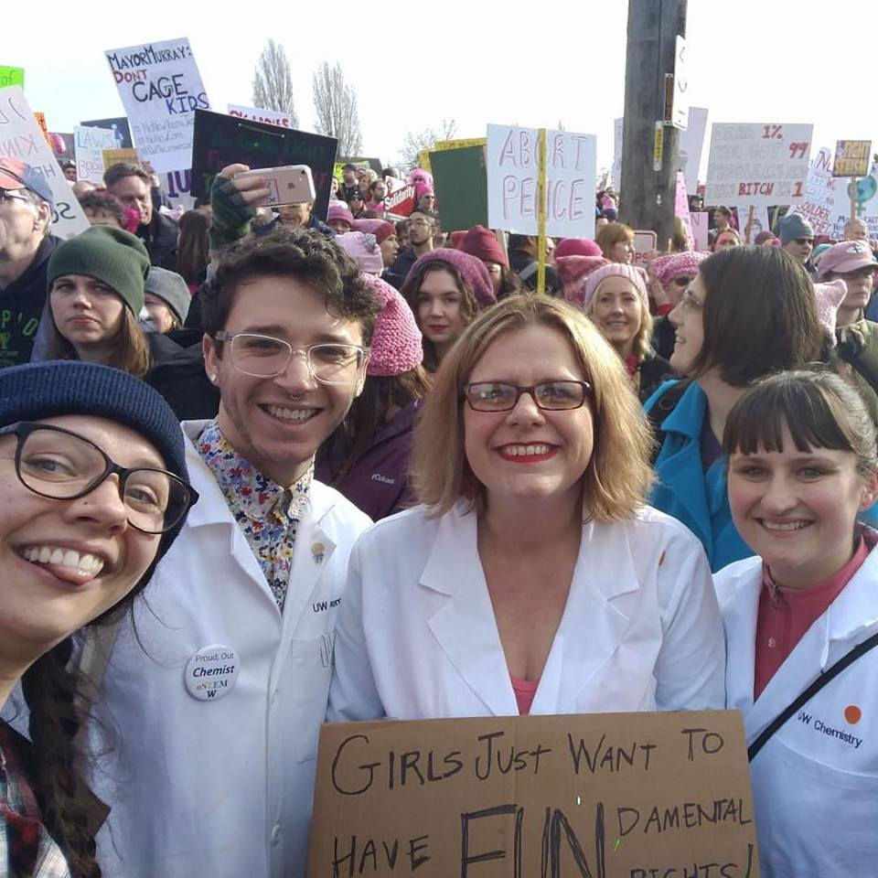
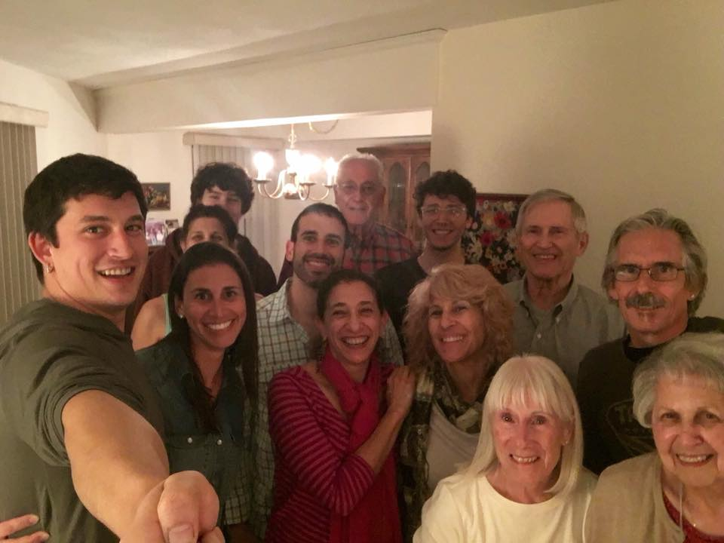

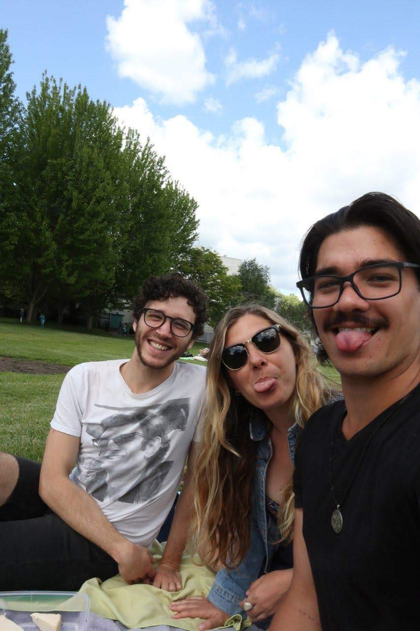


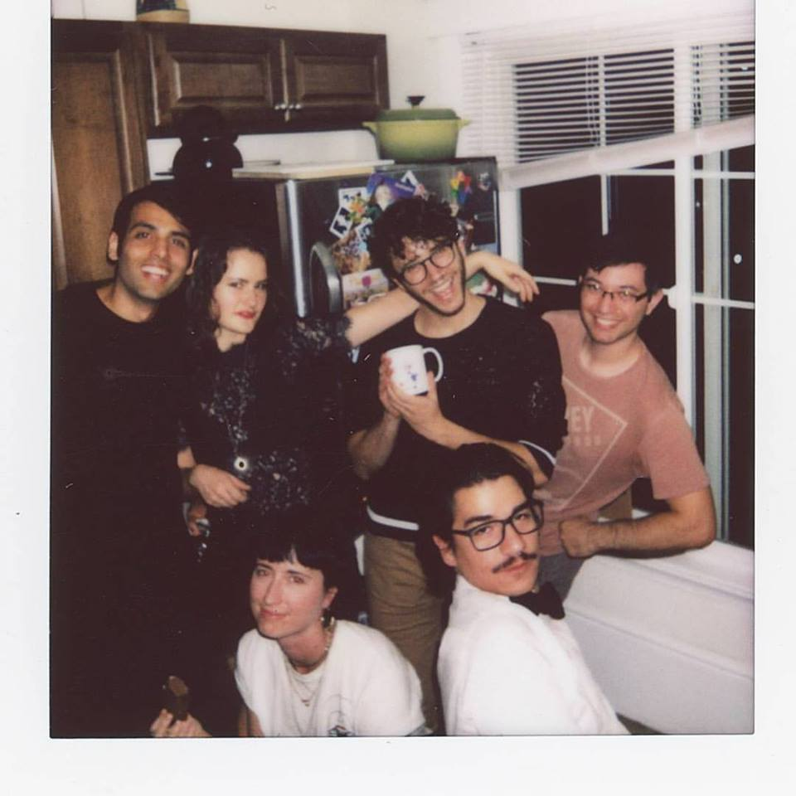

Slide 142
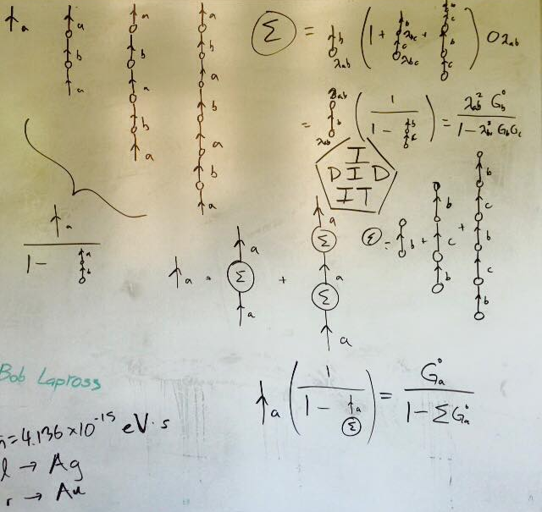
Questions?

Slide 143
EXTRA STUFF

Slide 145
Prism dipole moments
y-directed
x-directed

Slide 146
Magnetic Plasmon Spectrum of Hexagonally Packed Nanoclusters

Slide 147
Magnetic Plasmon Spectrum of Hexagonally Packed Nanoclusters

Slide 148
The size-dependence of magnetic plasmon energetics

Slide 149
The size-dependence of magnetic plasmon energetics

Slide 150
How I know the quasistatic model doesn’t work at large sizes:

Slide 151
Fully retarded model predicts multiple spectral switches

Slide 152
Oscillations in spacing calculations are due largely to the exponential term

Slide 153
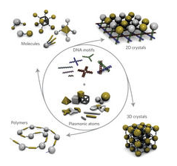
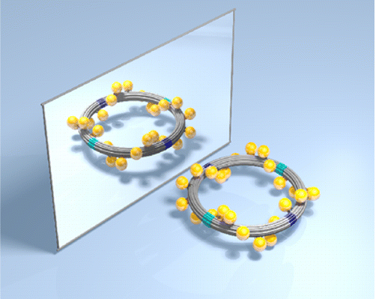
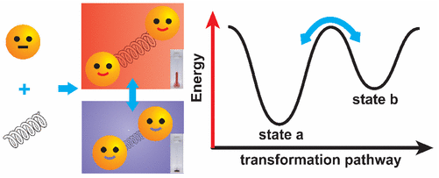
Realistically tunable variable: interparticle distance
Tan, S. et al. Nat. Nanotech. 2011
Urban, M. et al. JACS 2016
Qian,Z. et al. JACS 2017

Slide 154
Spacing: 2-mer
0
10

Slide 155
Spacing: Twomer
Tiny splitting! (< .01 eV)
0
10

Slide 156
Spacing: Twomer
0
10
0
10

Slide 157
Spacing: Twomer
Bigger splitting! (.01 - .1 eV)
0
10

Slide 158
Comparison of Length Scales
Length (nm)
Length (nm)

Slide 159
Conclusions
Magnetic plasmons exhibit tunable spectral ordering
This effect is more pronounced for oligomers with larger constituent particles
0
10

Slide 160
Characteristic Mode Wavelength
Length (nm)
Longest Distance

Slide 161
Characteristic Mode Wavelength
Length (nm)
Longest Distance
Retardation effects become important for this array when it is around ¼ the wavelength of light!

Slide 162
Photon-plasmon and electron-plasmon processes

Slide 163
Photon-plasmon and electron-plasmon processes
absorption

Slide 164
Photon-plasmon and electron-plasmon processes
scattering
absorption

Slide 165
Photon-plasmon and electron-plasmon processes
EELS
e⁻

Slide 166
Photon-plasmon and electron-plasmon processes
EELS
Cathodoluminescence
e⁻

Slide 167
Photon-plasmon and electron-plasmon processes
Electron energy-gain
spectroscopy
e⁻

Slide 168
Photon-plasmon and electron-plasmon processes
Stimulated EELS
e⁻

Slide 169
Photon-plasmon and electron-plasmon processes
Stimulated EELS
e⁻

Slide 170
Stimulated EELS

